Slide 1
Classification
CSCI 4047

Slide 2
Topics
Basic concepts of classification
Decision Trees
Naïve Bayes
Model Evaluation and Selection
  Recall
  Precision
  F-Score

Slide 3
Basic Concepts of Classification
It’s basic – not acidic.

Slide 4
Example Application
A credit card company receives thousands of applications for new credit cards. Each application contains information about the applicant:
  Age
  Marital Status
  Annual Salary
  Outstanding Debts
  Credit Rating
  Etc.
Problem: to decide whether an application should be approved → CLASSIFY the application into two categories: approved or not approved

Slide 5
Machine Learning and Our Focus
People learn from experiences
Computer system learns from data
Our focus: learn a target function that can be used to predict the values of a discrete class attribute (e.g., approved or not approved) and high-risk or low-risk
This task is often called supervised learning or classification

Slide 6
Data and the Goal
Data: a set of records (AKA examples, instances, or cases) described by
  k attributes: A₁, A₂, … A_{k}
  A class: each example is labelled with a pre-defined class
Goal: to learn a classification model from the data that can be used to predict the classes of new (future/test) cases/instances

Slide 7
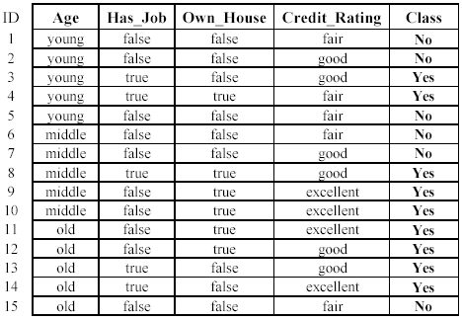
Example: Loan Application

Slide 8
The Learning Task
Learn a classification model from the data
Use the model to classify future loan applications
  Yes (approved)
  No (not approved)
What is the class for the following case/instance?

Slide 9
Classification – A Two-Step Process
Step 1: Model Construction involves describing a set of predetermined classes
  Each record/sample is assumed to belong to one predefined class
  The set of records used for model construction is the training set
  The model is represented as classification rules, decision trees, or mathematical formulae

Slide 10
Classification – A Two-Step Process
Step 2: Model Usage is for classifying future or unknown objects
  Estimate the accuracy of the model
    The classified result is compared with the known label of the test set
    Accuracy rate is the percentage of test set samples that are correctly classified by the model
    Test set MUST be independent of the training set, otherwise over-fitting will occur
    If the accuracy is acceptable, use the model to classify future data whose class labels are not known

Slide 11
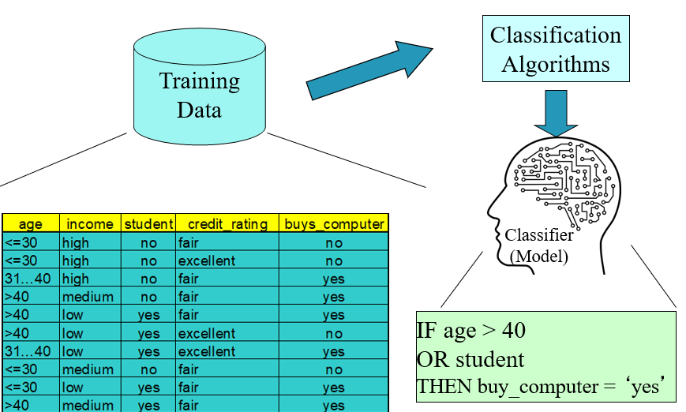
Process (1): Model Construction

Slide 12
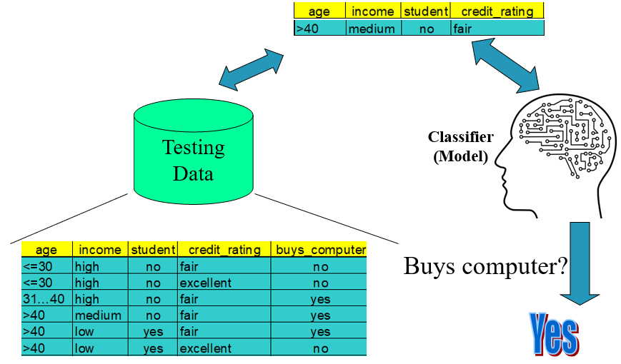
Process (2): Using the Model in Prediction

Slide 13
Decision Trees
Decisions don’t just grow on TREES…wait, do they??

Slide 14
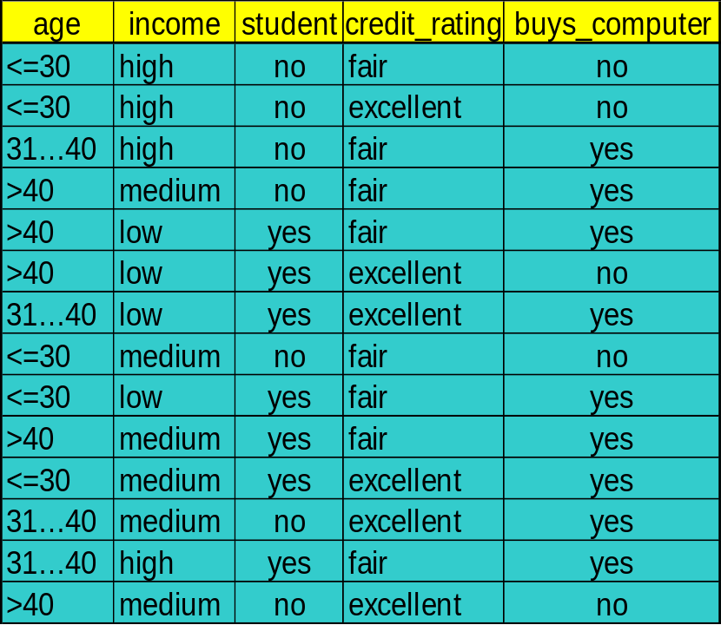
Decision Tree Induction: buys_computer Dataset
We want to predict whether the person will buy a computer based on these attributes – we need to pinpoint the most determining attributes for buying a computer

Slide 15
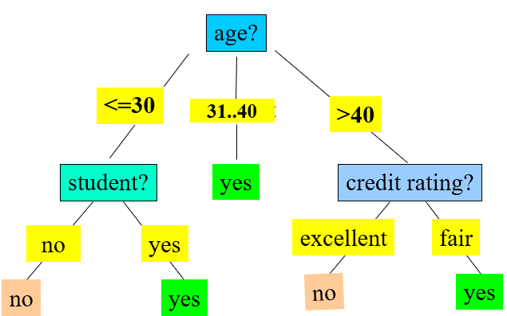
Decision Tree Induction: An Example
Training data set: buys_computer
Resulting decision tree:

Slide 16
Decision Tree Construction Algorithm
Attributes are categorical (if continuous, they are discretized e.g., age: 0-17, 18-34, etc.)
Start at the root and work down – the attribute that goes at the top (root) is the one that splits the data with the highest prediction accuracy
For each level in the tree (top to bottom), the attribute(s) are selected based on some statistical measure (e.g., Gini index, information gain, Gain ratio, etc.)
You stop picking attributes to split the data when:
  All samples for a given node belong to the same class / there are no samples left (i.e., all data under a tree node have the same label)
  There are no remaining attributes for further partitioning

Slide 17
Attribute Selection Measures
To pick the attribute that will go at the top (root) of the decision tree, a statistical measure is used to compare the accuracy of using each attribute in the data
Once the root of the decision tree has been picked, then the same statistical measure is calculated for the rest of the attributes to decide which one will become the first child, and so on until the tree is complete.
These three statistical measures, in general, return good results
Gini index (very popular, we will cover this one)
Information gain
Gain ratio

Slide 18
Gini Impurity
Gini Impurity is a measurement of the likelihood of an incorrect classification of a new instance of a random variable, if that new instance were randomly classified according to the distribution of class labels from the data set.
In other words, an attribute with lower Gini Impurity value is more accurate than attributes with higher Gini Impurity values. Thus, the attribute with the lowest Gini Impurity goes at the top of the tree.

Slide 19
Attribute Selection Measures Comparison
These three statistical measures, in general, return good results
  Gini index
    Has difficulty when # of classes is large (too many labels)
    Tends to favor tests that result in equal-sized partitions and purity in both partitions
  Information gain
  Gain ratio
    Tends to prefer unbalanced splits in which one partition is much smaller than the others

Slide 20
Naïve Bayes
Naïve fools ☹

Slide 21
Bayesian Classification: Why?
A statistical classifier: performs probabilistic prediction, i.e., predicts class membership probabilities
Foundation: Based on Bayes’ Theorem.
Performance: A simple Bayesian classifier, naïve Bayesian classifier, has comparable performance with decision tree and selected neural network classifiers
Incremental: Prior knowledge (acquired from classifier training) can be combined with newly observed data to achieve higher accuracies.

Slide 22
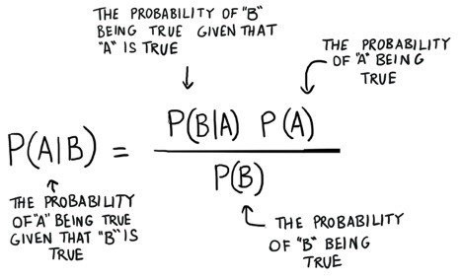
Naïve Bayesian Classifier
The Naïve Bayesian classifier is based on Bayes’ theorem with the independence assumptions between predictors
Despite its simplicity, the Naïve Bayesian classifier often performs very well and is widely used in predictive analytics

Slide 23
Example: Naïve Bayesian Classifier – Training Dataset
Class:
  C1 → buys_computer = ‘yes’
  C2 → buys_computer = ‘no’

Slide 24
Predicting with Naïve Bayes
P(C_{i}): P(buys_computer = “yes”) = 9/14 = 0.643
P(buys_computer = “no”) = 5/14= 0.357
Compute P(X|C_{i}) for each class
P(age = “<=30” | buys_computer = “yes”) = 2/9 = 0.222
P(age = “<= 30” | buys_computer = “no”) = 3/5 = 0.6
P(income = “medium” | buys_computer = “yes”) = 4/9 = 0.444
P(income = “medium” | buys_computer = “no”) = 2/5 = 0.4
P(student = “yes” | buys_computer = “yes) = 6/9 = 0.667
P(student = “yes” | buys_computer = “no”) = 1/5 = 0.2
P(credit_rating = “fair” | buys_computer = “yes”) = 6/9 = 0.667
P(credit_rating = “fair” | buys_computer = “no”) = 2/5 = 0.4
X = (age <= 30 , income = medium, student = yes, credit_rating = fair)
P(X|C_{i}) : P(X|buys_computer = “yes”) = 0.222 x 0.444 x 0.667 x 0.667 = 0.044
P(X|buys_computer = “no”) = 0.6 x 0.4 x 0.2 x 0.4 = 0.019
P(X|C_{i})*P(C_{i}) : P(X|buys_computer = “yes”) * P(buys_computer = “yes”) = 0.028
P(X|buys_computer = “no”) * P(buys_computer = “no”) = 0.007
Therefore, X belongs to class (“buys_computer = yes”)

Slide 25
Naïve Bayesian Classifier
Advantages
  Easy to implement
  Good results obtained in most of the cases
Disadvantages
  Assumption: attributes independence, therefore loss of accuracy
  Practically, dependencies exist among variables
    E.g., age and income
    Dependencies among these cannot be modeled by a Naïve Bayesian classifier

Slide 26
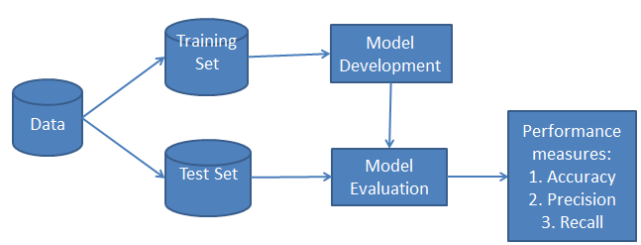
Classifier Evaluation Metrics
Yeah, I got nothing witty :/

Slide 27
Model Evaluation & Selection
Evaluation metrics: How can we measure accuracy? Other metrics to consider?
Use validation test set of class-labeled tuples instead of training set when assessing accuracy.
  In other words, split the labeled (known) data into two parts; one for training the model and the other part for testing the model and measuring its accuracy.
Methods to split the data into training set and testing set:
  Holdout method, random subsampling
  Cross-validation

Slide 28
Evaluating Classifier Accuracy
Holdout method
  Given data is randomly partitioned into two independent sets
    Training set (e.g., 2/3) for model construction
    Test set (e.g., 1/3) for accuracy estimation
  Random sampling: a variation of holdout
    Repeat holdout k times, accuracy = avg. of the accuracies obtained
Cross-validation (k-fold, where k = 10 is most popular)
  Randomly partition the data into k mutually exclusive subsets, each approximately equal size
  At i-th iteration, use D_{i} as test set and others as training set
  Leave-one-out: k folds where k = # of tuples, for small sized data
  *Stratified cross-validation*: folds are stratified so that class dist. in each fold is approx. the same as that in the initial data

Slide 29
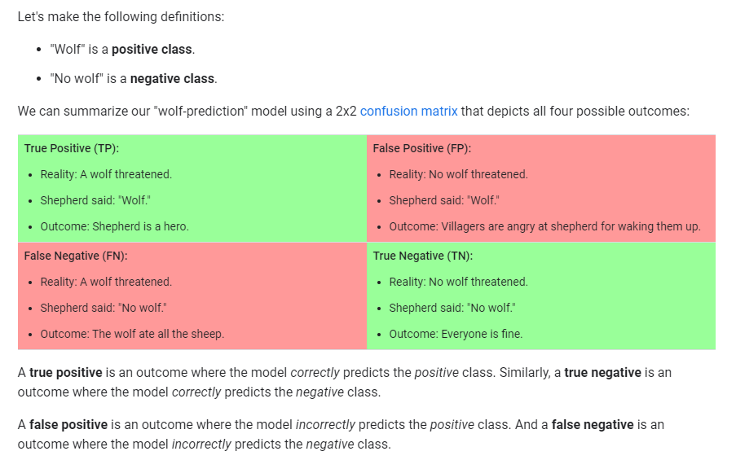
Classifier Evaluation Metrics – Primary Measures: TP, TN, FP, FN

Slide 30
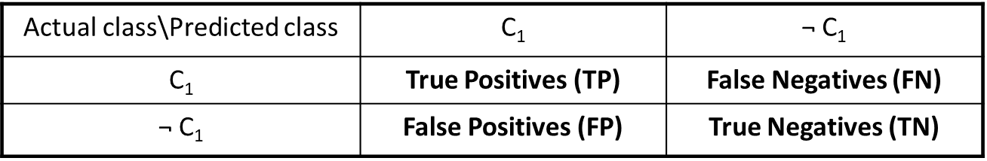
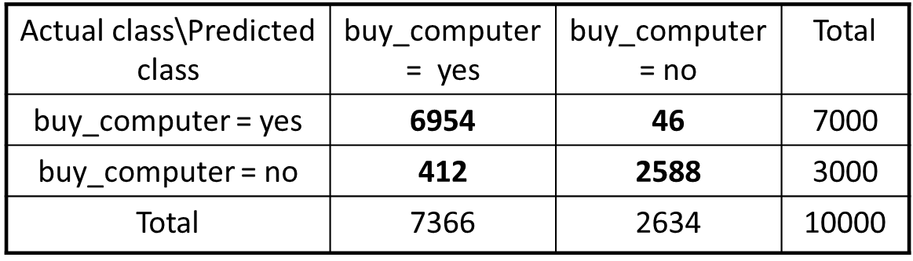
Confusion Matrix

Slide 31
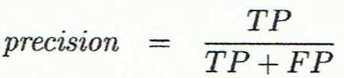
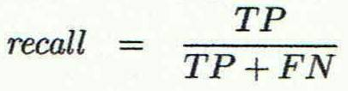
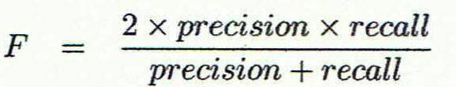
Precision, Recall, and F-Measures
Precision: exactness – what % of records that the classifier labeled as positive are actually positive
Recall: completeness – what % of positive records did the classifier label as positive?
F measure (F₁ or F-score): harmonic mean of precision and recall,
Perfect scores for recall, precision, and F-score is 1 (or 100%)

Slide 32
Interpreting Precision
Precision: exactness – what % of records that the classifier labeled as positive are actually positive
  A high precision (95%) means if the classifier detects that someone has COVID then there is 95% chance that they actually have COVID (true positive). However, there is 5% that the classifier is wrong and that person does not have COVID (false positive)
  A low precision (30%) means that if the classifier detects that someone has COVID, then there is 30% chance that they actually have COVID. However, there is 70% that the classifier is wrong and that person does not have COVID (false positive)

Slide 33
Interpreting Recall
Recall: completeness – what % of positive records did the classifier label as positive?
  A high recall (90%) means the classifier is able to detect 90% of people who have COVID. However, 10% will not be detected by the classifier. These 10% will be mistakenly labeled as healthy (false negative)
  A low recall (20%) means that the classifier detects only 20% of people who have COVID. However, it misses 80% of people who have COVID and mistakenly label them as not having COVID (or healthy) (false negative)

Slide 34
Recall vs. Precision
In a perfect world, high recall and high precision is best (i.e., your classifier is exact and complete)
Often, one classifier achieves high recall and low precision. Another classifier achieves low recall and high precision.
Choosing a classifier that achieves high recall and low precision: means you are ok with incorrectly detecting that some people have COVID when they are healthy (ok with higher false positives), as long as you do not miss people who actually have COVID and send them home (want lower false negatives)
Choosing a classifier that achieves low recall and high precision: means you are ok with miss diagnosing people who have COVID as healthy (ok with higher false negative), as long as often when your classifier says someone has COVID, that will be a correct detection (want lower false positives)

Slide 35
F-Score
Completeness vs Exactness is often not the decision for a data analyst to make (its for stakeholders such as physicians)
The F-score is a value that balances the recall and precision. It boils them to one value that can be used to measure the accuracy of classifiers.
Many data analysts measure the F-score for the models and try to maximize it.

Slide 36
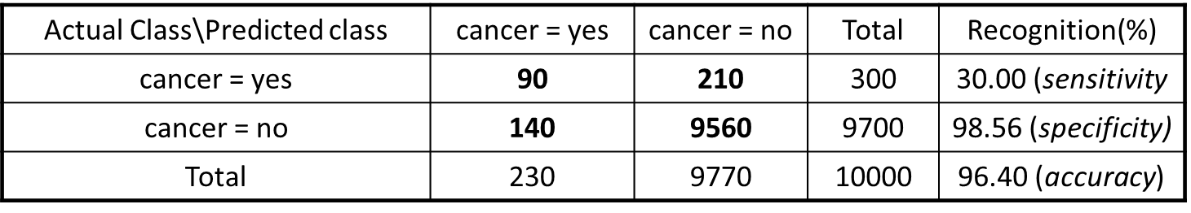
Classifier Evaluation Metrics: Example
Precision = 90/230 = 39.13% (inaccurate)
Recall = 90/300 = 30.00% (bad detection)

Slide 37
Keep in Mind: Evaluation of Classification Methods
Accuracy
  classifier accuracy: predicting class label
Speed
  time to construct the model (training time)
  time to use the model (classification/prediction time)
Robustness: handling noise and missing values
Scalability: efficiency in dealing with a large amount of data
Interpretability
  understanding and insight provided by the model
Other measures, e.g., goodness of rules, such as decision tree size or compactness of classification rules

Slide 38
Summary
Classification and prediction are two forms of data analysis that can be used to extract models describing important data classes or to predict future data trends.
Stratified k-fold cross-validation is a recommended method for splitting the data into training set and testing set for accuracy estimation.
Recall, Precision, and F-score are useful for model accuracy evaluation.
There have been numerous comparisons of the different classification and prediction methods, No single method has been found to be superior over all others for all data sets
Issues such as accuracy, training time, robustness, interpretability, and scalability must be considered and can involve trade-offs, further complicating the quest for an overall superior method

